Slide 1
What’s new in Windows & Narrator
December 5, 2017
Jiaxin Zheng

Slide 2
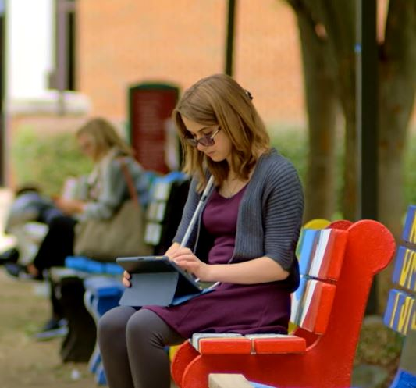
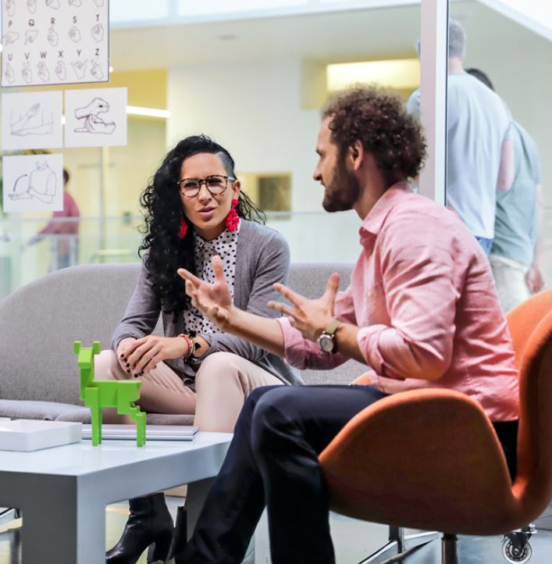
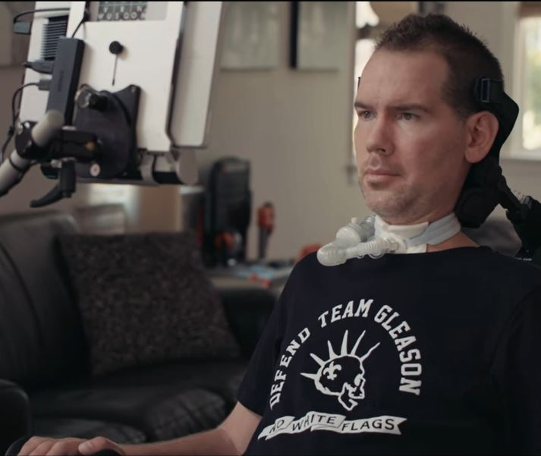
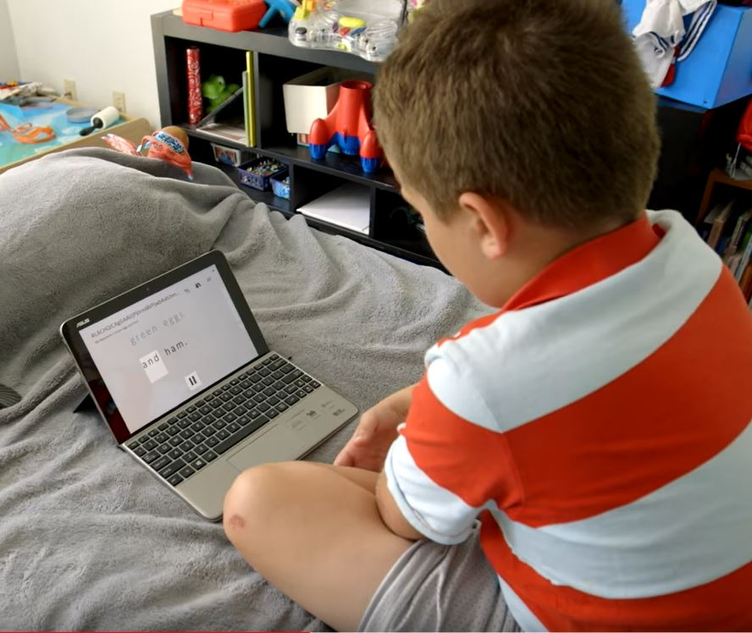
Windows 10 Accessibility
vision
hearing
physical
cognition
Make your device easier to see or use without a screen
Make your device easier to hear or use without sound
Make your device easier to use if you have limited reach or strength
Make it easier to focus and get things done with Windows
Notes:
We have many features and tools to address vision, hearing, physical, and cognitive impairments, built into the Windows platform.
Whether you have a visual disability or a visual preference, Windows accessibility strives to provide options for enabling multiple abilities and working styles.
We want you to personalize your Windows experience so that it is the best for YOU.
Need to want to love

Slide 3
Built In Windows 10 Assistive Technologies
Continued investment in Windows accessibility
vision
hearing
physical
cognition
Color Filters
Narrator investments
Closed captions
Mono audio
Eye Control
Sticky Keys
Read Aloud
Dictation

Slide 4
Narrator Investments
Make your device easier to use
without a screen
Select New Narrator Features in Windows 10:
High speed voices
Intelligent Image descriptions
Scan Mode
Braille Support
Narrator and Magnifier working together
Autosuggest built into the platform
Spellcheck Feedback

Slide 5
Braille in Narrator Beta
Windows 10 narrator supports braille displays from over 25 manufactures
A braille keyboard can be used for entering commands or entering text in contracted or uncontracted braille
In the Fall Creators update, we also added the highly requested ability to perform keyboard shortcuts like Ctrl+S or Alt+Tab via commands on a braille keyboard
Link to list of supported braille displays
Link to braille support in narrator user guide

Slide 6
Braille Core Narrator Commands
Even braille displays without a braille keyboard have the following core Narrator commands available:
Primary action
Secondary action
Show context menu
Pan braille right/left
Braille home*, end*, next*, previous*, first*, last*
Select navigation mode (This sets line, heading, or link, etc. for the other commands with *)

Slide 7




Vision
Make your device easier to see or use
without a screen
Spotlight: Color Filters
Notes:
Built in not bolted on
Features that are shipped out of the box: one of them is color filters.
We were originally thinking of people with colorblindness, and providing them an out of the box solution to make visual content more accessible. As it turns out, we’ve heard that some people without colorblindness have started using these features too because they look and feel better.
So what exactly does it look like? Here’s a picture without color filters, and then here are 3 of our 6 color filters applied.
As you can see, there is a range of human visual ability, and rather than shying away from that fact, we’re embracing it to ship a product that has this color filters feature built in instead of bolted on.

Slide 8
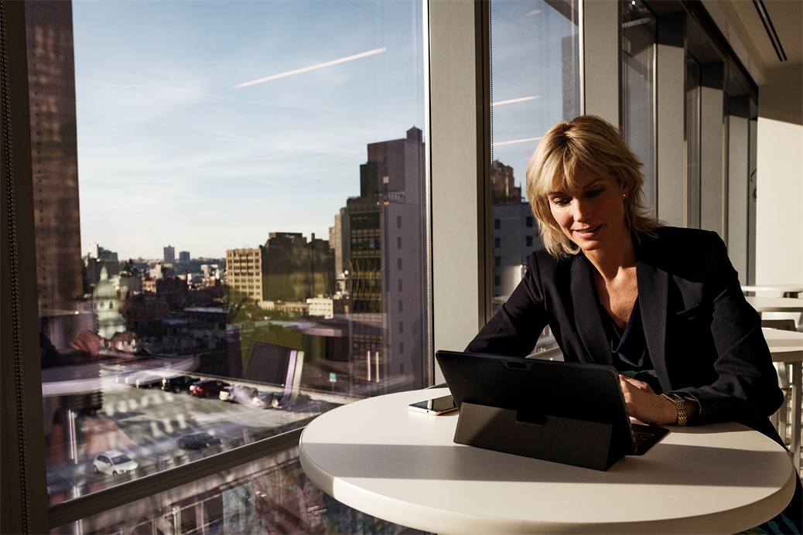

Hearing
Make your device easier to hear or use
without sound
Spotlight: Closed captions in a busy cafe
Notes:
Inclusive design in action
Many of you here may travel for work, for example, to a conference in Taipei, or work remotely from coffee shops. I know when I’m traveling, I often myself trying to get things done in a crowded conference center, or at a café cause it’s only place that has wifi.
Even with headphones on, it can be difficult to watch a video. Thus, utilizing one our accessibility features, CLOSED CAPTIONS, is a great solution for this situational disability.
This is a great example, of inclusive design in action. Closed captions, not just in Windows but all up, were originally designed to accommodate people with hearing impairments, but the benefits of closed captions have multiplied to many.
How many times have you scrolled through your facebook feed, video, etc?
Or how many of you, along with listening to my beautiful voice, are also reading the captions?
Just goes to demonstrate how inclusive design benefits many, and it’s a core principle that guides the Windows Accessibility team.

Slide 9
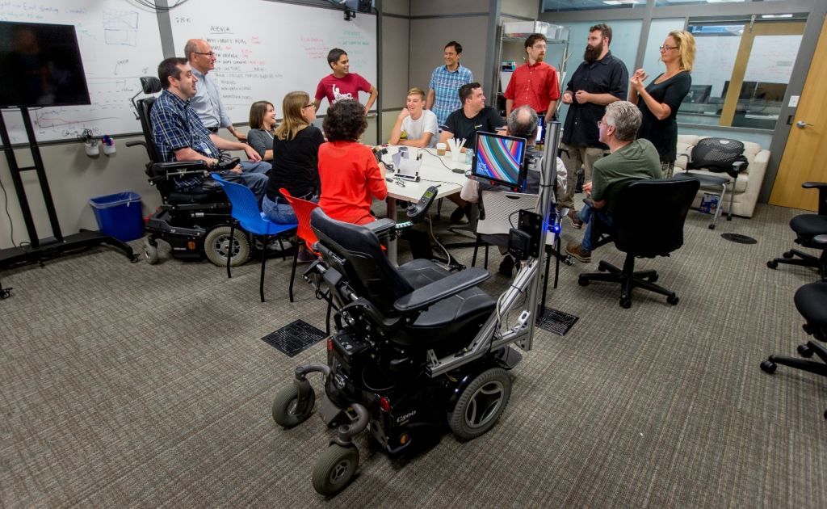
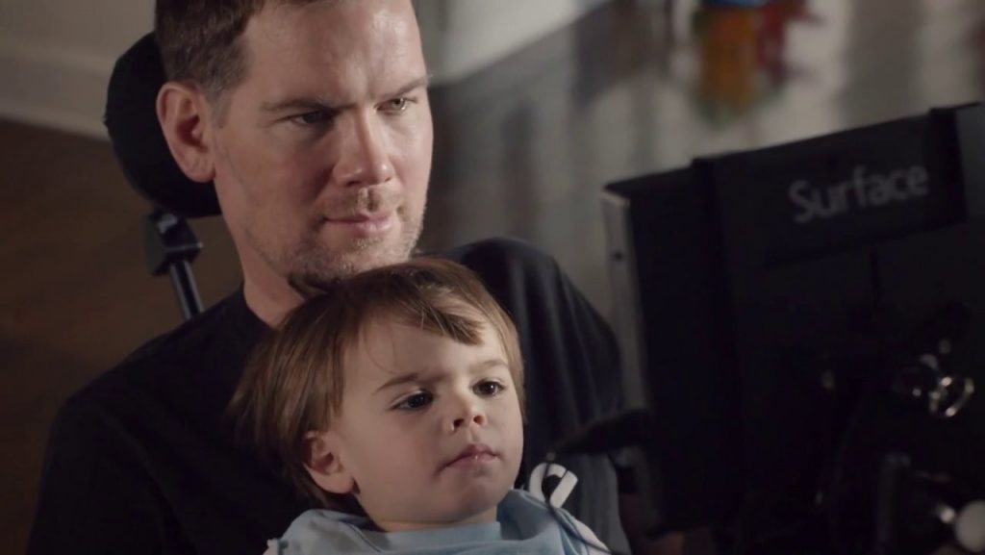
Physical
Make your device easier to use of you
have limited reach or strength
Spotlight: Eye Control and Steve Gleason
Notes:
People centered, scenario focused
There’s a spectrum of disabilities, and this holds especially true with physical impairments. Whether you have carpel tunnel in your forearms that make it difficult to use a mouse, or you don’t have control of your arms at all, our tools focused on addressing physical impairments center around providing alternative input methods to Windows.
Eye control is the perfect example of providing other accessible input methods for Windows. How it all began, is with Steve Gleason, a former professional American football player.
Back in 2011, Gleason was diagnosed with ALS, a muscular neuron degenerative disease, where motor neurons degrade, and you lose control over most of your muscles. Gleason was formerly a football player in peak physical condition, and because of this disease, uses a wheelchair and cannot physically speak.
In 2014, he came to Microsoft with a challenge: to create technology that will allow him to independently control his wheelchair and better communicate with his loved ones.
What resulted from that was an eye controlled wheel chair, and that’s what inspired the Eye Control support that shipped with the Windows 10 Fall Creators Update.
There are real people behind the features and products we ship. Steve Gleason wanted to better connect with the people he loved, and eye control is one of the ways we’re enabling that.

Slide 10
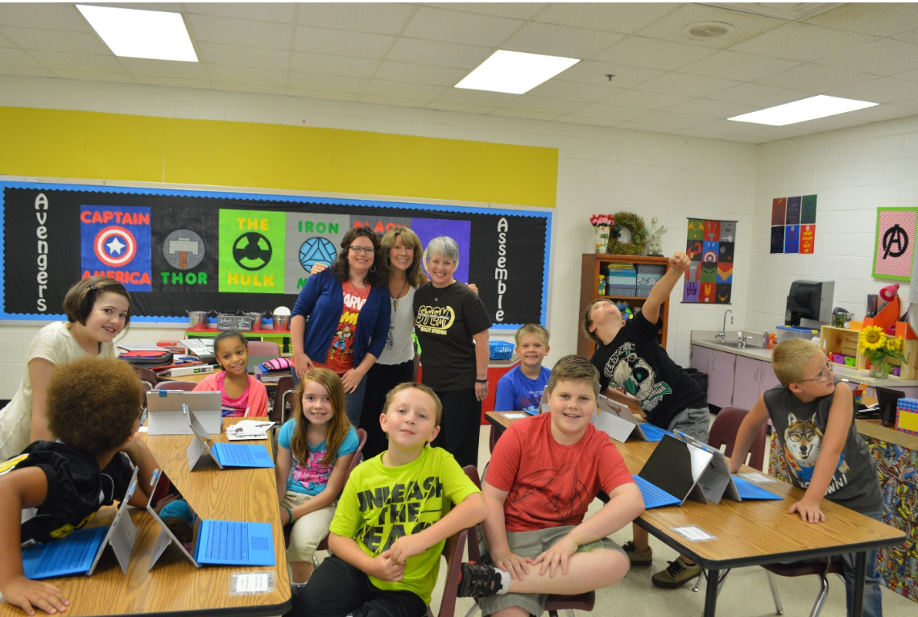
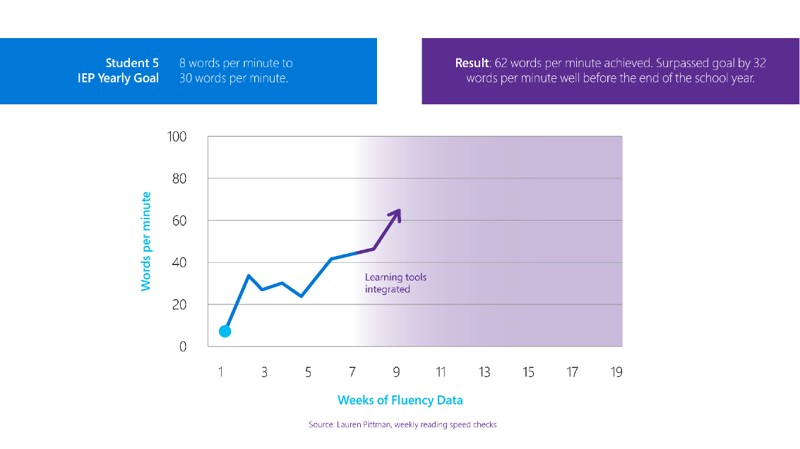
Cognition
Make it easier to focus and get things
done with Windows
Spotlight: Learning Tools and Lauren Pittman
Notes:
Accessibility has huge implications
Last, but certainly not least, iare our tools surrounding cognition. It’s about making it easier to focus and get things done with Windows.
I want to tell the story of Lauren Pittman, an American teacher in Atlanta, Georgia. She is a special education teacher, and many of her students have dyslexia.
Dyslexia is a learning disability that makes it difficult to read and write: words jumble together, and they don’t necessarily jump out at you as they would for someone without dyslexia.
Learning tools was a set of features originally built into Office, built with research on best teaching methods for students with dyslexia. We’re bringing it to more experiences with the most recent Windows 10 update, and through our partnership with Lauren’s classroom, we know that learning tools are proven to work.
One student was reading at 8 words per minute, and ended up achieving 62 words per minute with the help of learning tools.
That’s a student who can now learn to read, so that in the future, he can read to learn.
Lauren Pittman and the students she serves everyday just go to show that accessibility has huge implications.
While to some people, accessibility seems like just another bullet point on an ever growing to do list, it is a world of difference for someone with disabilities. it can mean being able to read or failing your classes. It can mean finding a career that gives you meaning or being unemployed.
It’s not something we take lightly.

Slide 11
Windows Accessibility Demos

Slide 12
Accessibility Demos
Eye Control (4min)
Showing the calibration process
Respond to an email
Pull up twitter
Color Filters (2min)
Toggle on and off with the color wheel
Demonstrate it in Excel file
Narrator and Magnifier Integration (6min)
High speed voices
Intelligent Image descriptions
Scan Mode
Braille Support
Narrator and Magnifier working together
Autosuggest built into the platform
Spellcheck Feedback
Read aloud in Microsoft Edge (3min)
Demo Read Aloud on Wuthering Heights
Quickly demo Dictation as well (2min)
Total: 15min

Slide 13
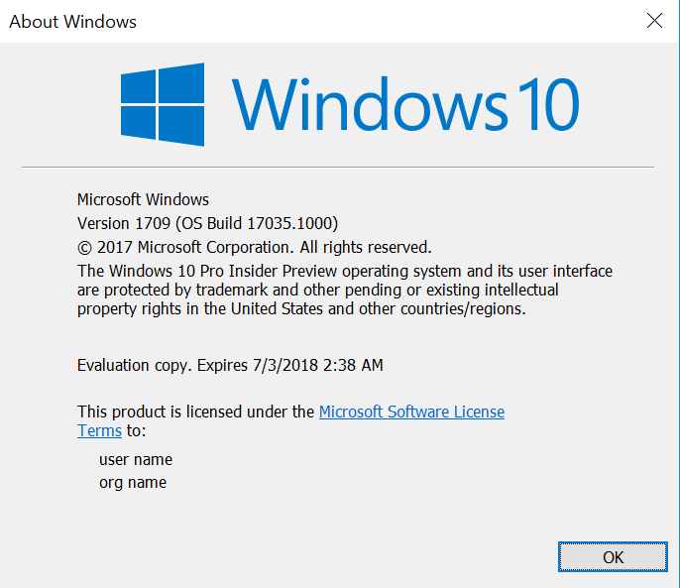
Windows 10 Updates
Creator’s Update
March 2017
Version 1703
Fall Creator’s Update
October 2017
Version 1709
Type winver into your start search bar to confirm Windows Version

Slide 14
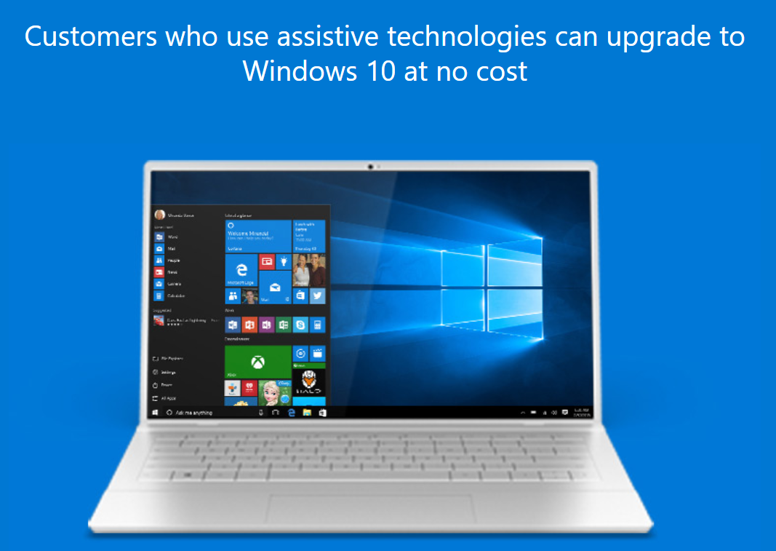
Free Windows 10 Upgrade
Free Upgrade to Windows 10 for AT Users
Extended to Dec 31st 2017
Will be a case by case basis after that
Link to the free upgrade

